Slide 1

Maximum & Minimum Applied Example 3
RCET 0264 Introductory Calculus
Tim Leishman

Slide 2
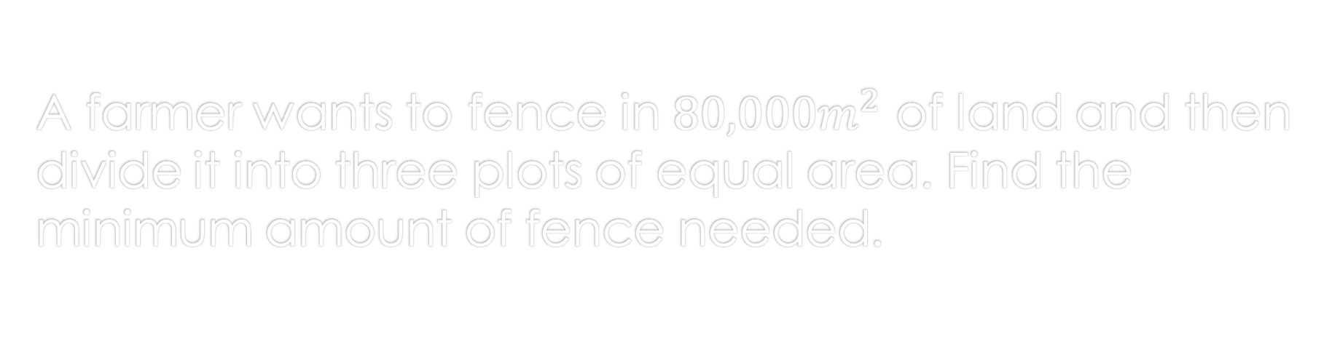
Maximum & Minimum
A farmer wants to fence in $80,000m^{2}$ of land and then divide it into three plots of equal area. Find the minimum amount of fence needed.

Slide 3
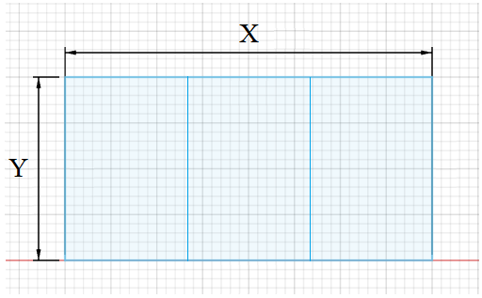
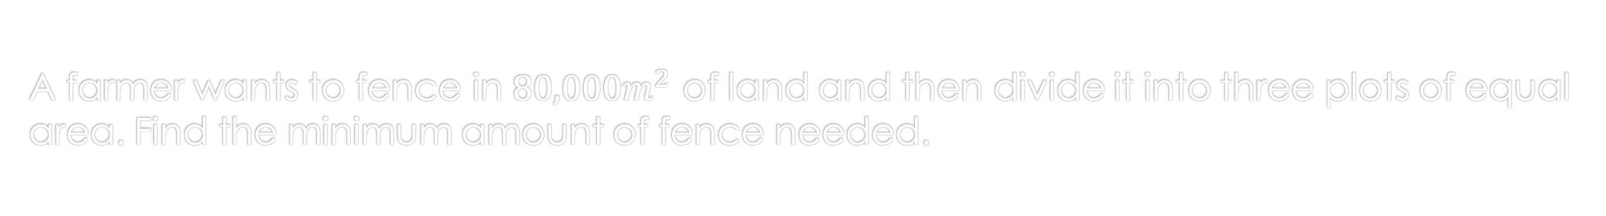
Maximum & Minimum
A farmer wants to fence in $80,000m^{2}$ of land and then divide it into three plots of equal area. Find the minimum amount of fence needed.

Slide 4

Maximum & Minimum
A farmer wants to fence in $80,000m^{2}$ of land and then divide it into three plots of equal area. Find the minimum amount of fence needed.
$$Area =80,000m^{2}$$
$$X×Y=80,000m^{2}$$
$$Total fence=2X+4Y$$
Minimum amount of fence?
$Total fence=2X+4Y$
$X×Y=80,000m^{2}$
$X=\frac{80,000m}{Y}$
$Total fence=2(\frac{80,000m}{Y})+4Y$
$Total fence=\frac{160,000m}{Y}+4Y$
$Total fence=160,000mY^{−1}+4Y$

Slide 5



Maximum & Minimum
A farmer wants to fence in $80,000m^{2}$ of land and then divide it into three plots of equal area. Find the minimum amount of fence needed.
Minimum amount of fence?
$Total fence=160,000mY^{−1}+4Y$
$\frac{dTotal fence}{dy}=−160,000mY^{−2}+4$
$\frac{dTotal fence}{dy}=\frac{−160,000m}{Y^{2}}+4$
$0=\frac{−160,000m}{Y^{2}}+4$
$−4=\frac{−160,000m}{Y^{2}}$
$−4Y^{2}=−160,000m$
$Y^{2}=\frac{−160,000m}{−4}$
$Y^{2}=40,000m$
$Y=√40,000m$
$Y=200m$
$$Area =80,000m^{2}$$
$$X×Y=80,000m^{2}$$
$$Total fence=2X+4Y$$

Slide 6


Maximum & Minimum
A farmer wants to fence in $80,000m^{2}$ of land and then divide it into three plots of equal area. Find the minimum amount of fence needed.
$$Area =80,000m^{2}$$
$$X×Y=80,000m^{2}$$
$$Total fence=2X+4Y$$
$Y=200m$
$$Area =80,000m^{2}$$
$$X×Y=80,000m^{2}$$
$$Total fence=2X+4Y$$
Minimum amount of fence?
$Total fence=2X+4Y$
$X×Y=80,000m^{2}$
$Y=\frac{80,000m}{X}$
$Total fence=2X+4\frac{80,000m}{X}$
$Total fence=2X+\frac{320,000m}{X}$
$Total fence=2X+320,000mX^{−1}$

Slide 7

Maximum & Minimum
A farmer wants to fence in $80,000m^{2}$ of land and then divide it into three plots of equal area. Find the minimum amount of fence needed.
Minimum amount of fence?
$Total fence=2X+320,000mX^{−1}$
$\frac{dTotal fence}{dx}=2−320,000mX^{−2}$
$0=2−320,000mX^{−2}$
$0=2−\frac{320,000m}{X^{2}}$
$−2=\frac{−320,000m}{X^{2}}$
$X^{2}=\frac{−320,000m}{−2}$
$X^{2}=160,000m$
$X=\sqrt{160,000m}$
$X=400m$
$$Area =80,000m^{2}$$
$$X×Y=80,000m^{2}$$
$$Total fence=2X+4Y$$
$Y=200m$

Slide 8



Maximum & Minimum
A farmer wants to fence in $80,000m^{2}$ of land and then divide it into three plots of equal area. Find the minimum amount of fence needed.
$$Area =80,000m^{2}$$
$$X×Y=80,000m^{2}$$
$$Total fence=2X+4Y$$
$Y=200m$
$X=400m$
Minimum amount of fence?
$Total fence=2X+4Y$
$Total fence=2\left(400m\right)+4\left(200M\right)$
$Total fence=800m+800m$
$Total fence=1600m$

Slide 9
Maximum & Minimum
References:
Ewen, D., Gary, J. S., & Trefzger, J. E. (2005). Technical calculus. Upper Saddle River, NJ: Pearson/Prentice Hall.
https://www.desmos.com
https://www.autodesk.com/products/fusion-360/overview

